Slide 1
DATA COLLECTION AND ANALYSIS
Introduction to Research PPT7

Slide 2
Genearlly speaking, two types of data can be distinguished:
1. Quantitative data
2. Qualitative data

Slide 3
1. Qualitative data
Data collected by means of observation of the environment in which you are interested such as text, photos and people.
Qualitative/Categorical data represents groupings.
These may be nominal (e.g., gender) or ordinal (e.g. level of language ability).

Slide 4
2. Quantitative data
Numerical results of measured or simulated variables.
Quantitative data represents amounts.
These may be on an interval scale (e.g. test score) or a ratio scale (e.g. age).

Slide 5
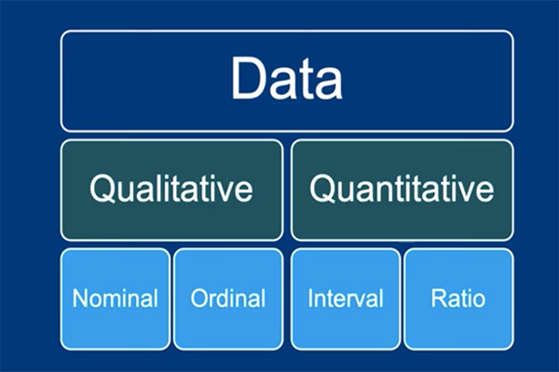

Slide 6
Nominal: Data values with no intrinsic order. It typically distinguishes groups (e.g. male vs female)

Slide 7
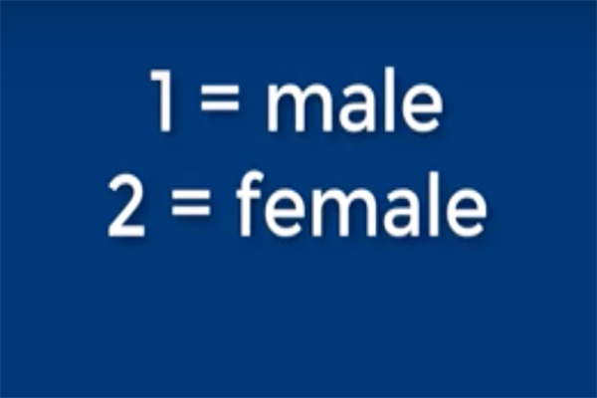
Nominal

Slide 8
Ordinal: Qualitative data values with some intrinsic order.

Slide 9

Ordinal (e.g. low, medium and high)

Slide 10
Interval: Numeric values on an interval scale, order is known, exact differences in values.

Slide 11
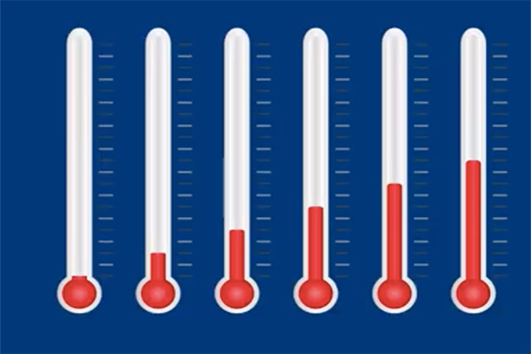
Interval (e.g. Temp. levels)

Slide 12
Ratio: Same as “interval” but with absolute zero
(e.g. Length or execution time of a program)

Slide 13
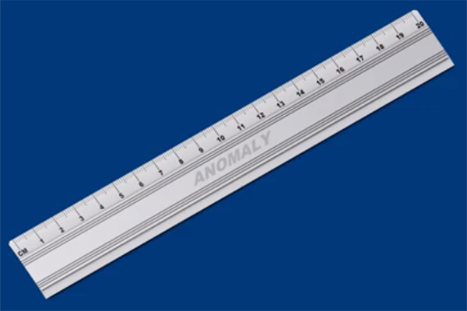
Ratio (e.g. age )

Slide 14
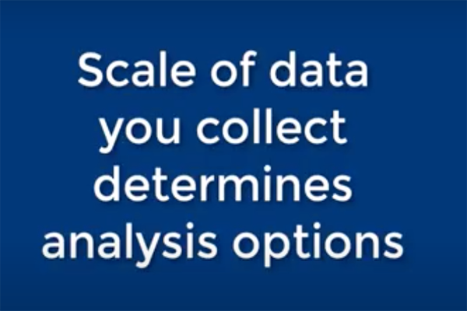

Slide 15
The type of scale you collect your data in will, in part, determine the type of analysis you can carry out.
This is important to take into account when you set up you experiment or observations.
Especially ordinal data can be quite limiting in terms of analysis options.

Slide 16
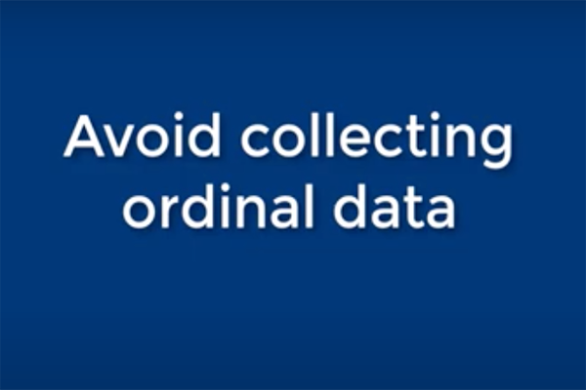

Slide 17
You can always create ordinal data from interval and ratios, but vice versa is not possible.

Slide 18
Data collection
What data sources am I going to use?
Generating your own through testing or surveying or observing
Someone else's data
Simulated data
Theoretical data

Slide 19
Keep records
Record data origin, and time and circumstances of data collection!
Hence the importance of keeping a Log Book

Slide 20

Log Book

Slide 21
Data Analysis
The purpose of data analysis is to find the answers to your research questions.
It is important that you pick the right analysis tool that is Reliable and Valid for the research method you have designed and carried out.
Every analysis tool has its pros and cons. Always carry out a trade off which tool is suitable for your type of data.

Slide 22
Data analysis
The process of cleaning, transforming, and interpreting data to uncover insights, patterns, and trends.

Slide 23
Data analysis in a nutshell?
Step 1: Plan your hypothesis and research design.
Step 2: Obtain data from a representative sample.
Step 3: Analyze and summarize your data.
Step 4: Analyze hypotheses and make inferences using inferential statistics.
Step 5: Interpret your results.

Slide 24
Inferential statistics
Involves the use of a sample:
(1) to estimate some characteristic in a large population; and
(2) to test a research hypothesis about a given population.

