Slide 1
RESEARCH QUESTION AND HYPOTHESIS
Introduction to Research PPT6

Slide 2
You are making a prediction on the outcome of your research.
A hypothesis is a tentative and yet untested answer to you research question.
However, it is not a form of fortune-telling

Slide 3
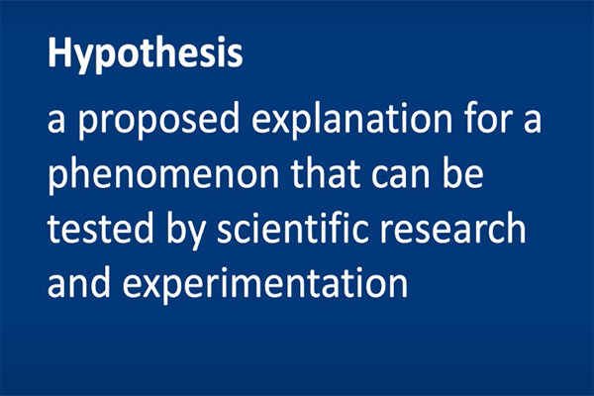

Slide 4
You must be able to confirm or reject the hypothesis using scientific methods such as experiment, measurement, observation and statistical analysis of data.

Slide 5
Two requirements
1. Contain an educated predition of the answer to the research question
2. Must be testable

Slide 6
Research question to Hypothesis
How do you develop a hypothesis from a research question?
Assuming that your research question is sufficiently focused, specific and researchable, within the constraints, context of your project, you develop an initial answer to your question.

Slide 7


Slide 8


Slide 9


Slide 10
This answer is based on what you already know, or can find out about the topic from previous studies and existing theories.

Slide 11
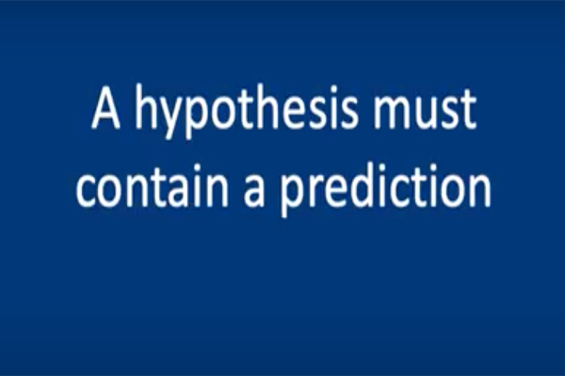

Slide 12
Also in the construction of your framework, you already looked at the variables you need to study and the relationship that may exist beween them.
This gives an idea of what outcome you may expect.

Slide 13


Slide 14
Now formulate your hypothesis by writing the initial answer to the research question

Slide 15

Formulating the research question

Slide 16
Example: Our class project …
ICT enhances ELT by offering tools and platforms that support interactive and personalized learning. It provides access to authentic language materials, promotes collaborative learning, and fosters digital literacy.

Slide 17
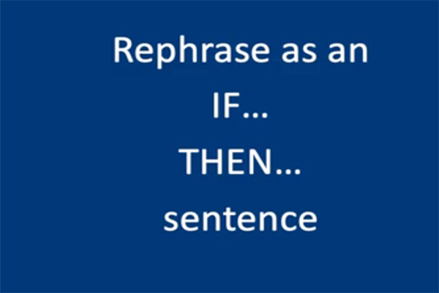

Slide 18
If … Then
Example: Our class project ..
If ICT is introduced in the ELT class, then students will achieve better test results as it offers tools and platforms that support interactive and personalized learning.

Slide 19
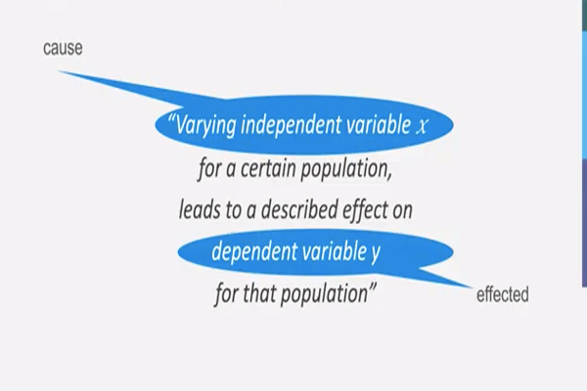
Typical format of a hypothesis

