Slide 1
HOW TO RESEARCH / METHODS
Introduction to Research PPT5

Slide 2
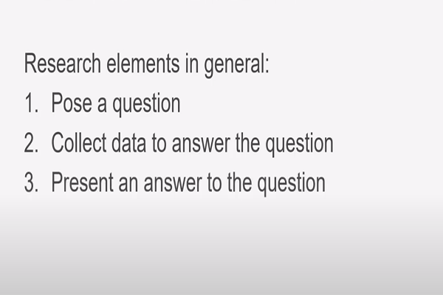
Method #1: QUALITATIVE

Slide 3
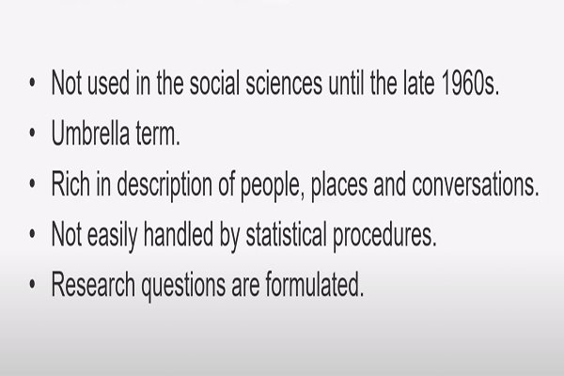

Slide 4
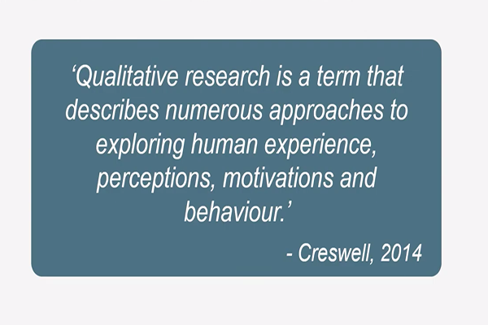

Slide 5
Method #2: Quantitative
Quantitative research deals with data that are in numerical form, or data that can be converted into numerical form.
Example 1: Time measured by hours, minutes, seconds or milliseconds.
Example 2: Opinions that are measured through questionnaire, such as getting individuals to rate their level of satisfaction.

Slide 6
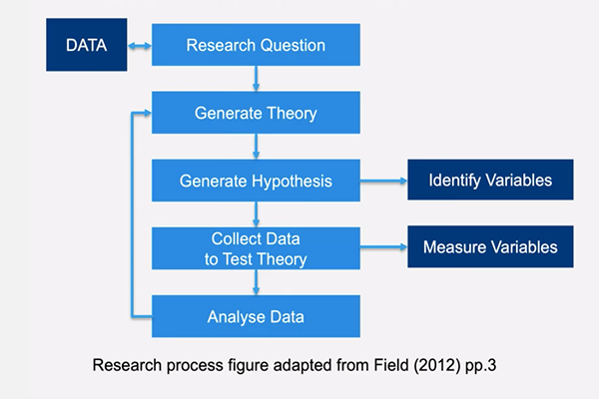

Slide 7
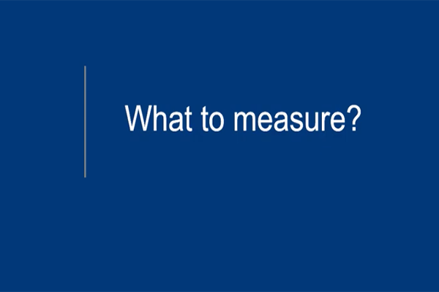

Slide 8
In research, variables are any characteristics that can take on different values, such as height, age, temperature, or test scores.
Researchers often manipulate or measure independent and dependent variables in studies to test cause-and-effect relationships.

Slide 9
The independent variable is the cause. Its value is independent of other variables in your study.
The dependent variable is the effect. Its value depends on changes in the independent variable.

Slide 10
Example: Our class project to test whether changes in the use of ICT have an effect on English test scores:
Our independent variable is the use of ICT the classroom. We use ICT for half the participants, and none for the other half.
Our dependent variable is English language test scores. We measure the English skills of all participants using a standardized test and check whether they differ based on the use or not of ICT.

Slide 11
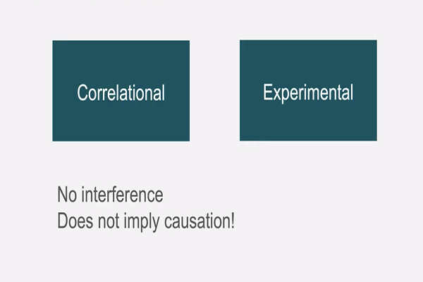

Slide 12
“Controlled experiments” establish causality, whereas “correlational studies” only show associations between variables

Slide 13
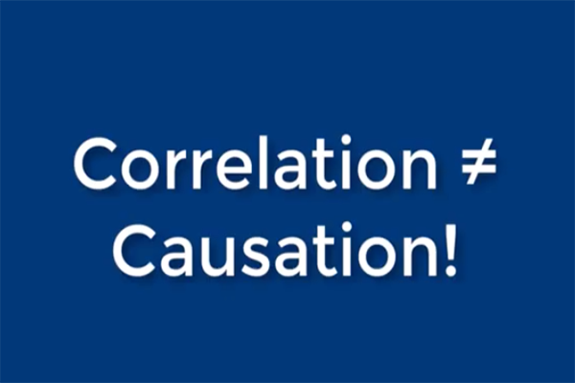

Slide 14
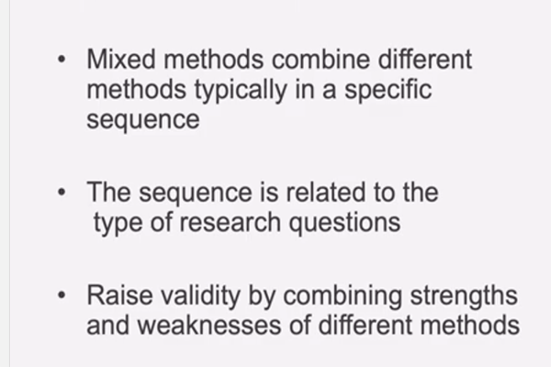
Method #3: Mixed

Slide 15
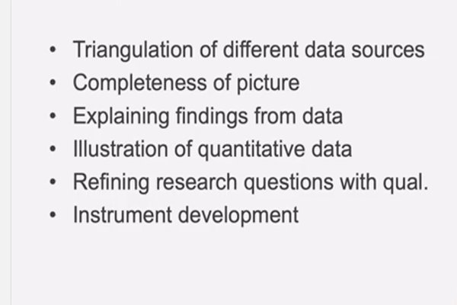
Benefits of mixed method approaches

Slide 16
Triangulation
Triangulation in research means using multiple datasets, methods, theories, and/or investigators to address a research question. It's a research strategy that can help you enhance the validity and credibility of your findings and mitigate the presence of any research biases in your work.

Slide 17
Combining advantages of different data types, completing each other.
Example: using a questionnaire, combining with interview.

Slide 18
Explain and interpret quantitative results
Example: why is one method of teaching better than the other?

Slide 19
One type of data augments the other one; there is a primary type of data
Example: Longitudinal studies combined with also cross-sectional studies

Slide 20
Longitudinal study
Collects data from the same subjects repeatedly over a period of time. These studies track changes, patterns, or trends, making them ideal for analyzing the evolution of specific variables, such as behavior, health outcomes, or economic conditions. For example, a public health researcher may conduct a longitudinal study to monitor how dietary habits influence heart health over 10 years.

Slide 21
Cross-sectional study
Collects data at a single point in time. This snapshot approach is commonly used to explore the prevalence of a condition, opinion, or characteristic in a population at a singular point in time. For instance, a humanitarian organization might use a cross-sectional study to determine how many residents in a community currently have access to clean drinking water, or a healthcare organization could use a cross-sectional study to determine vaccine rates in a province for that year.

Slide 22
The fundamental difference lies in time:
longitudinal studies span across periods, capturing change,
cross-sectional studies focus on a single moment, providing a snapshot.

Slide 23
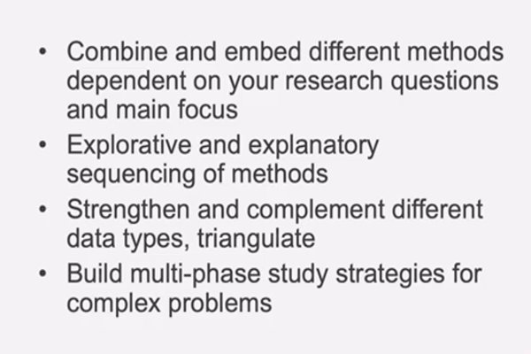
Mixed method in a nutshell

Slide 24
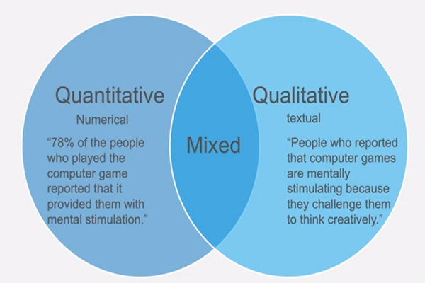
Overview

