Slide 1
DESKTOP RESEARCH AND LITERATURE REVIEW
Introduction to Research PPT4

Slide 2


Slide 3
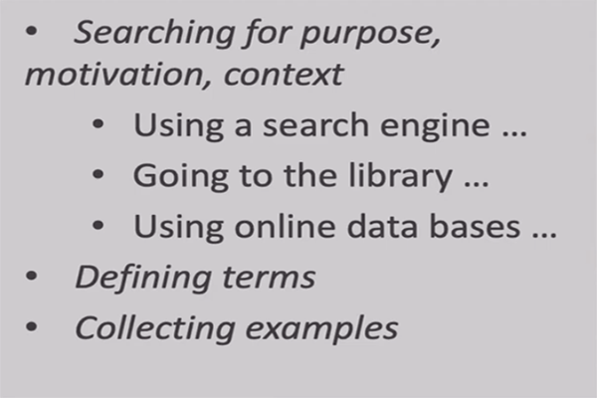
What is secondary or desktop research?

Slide 4
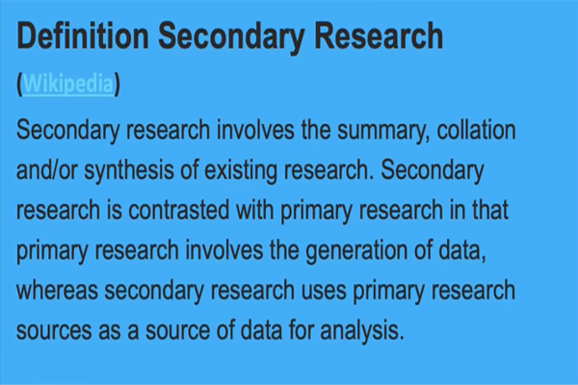
What is the purpose of your research?

Slide 5

Example: ICT in ELT

Slide 6
Modern research is about weaving together different strands of information, thought, and data to place your results into the context of existing research.

Slide 7
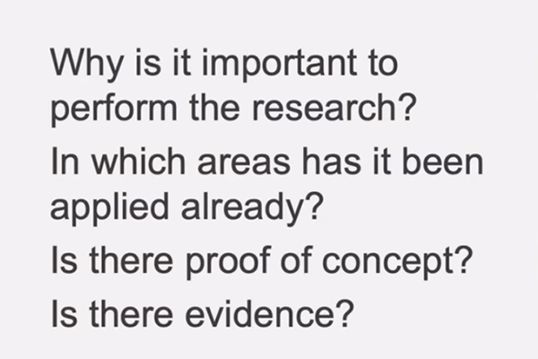
Significance

Slide 8
Significance
The use of technology in language classroom can play an important role to implement the new curriculum. Nowadays some of the educational institutions are using different technology and internet to teach language. The use of technology and internet in ELT classroom enhance language learning.

Slide 9


Slide 10
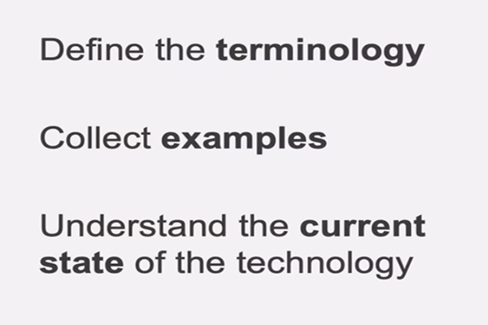

Slide 11
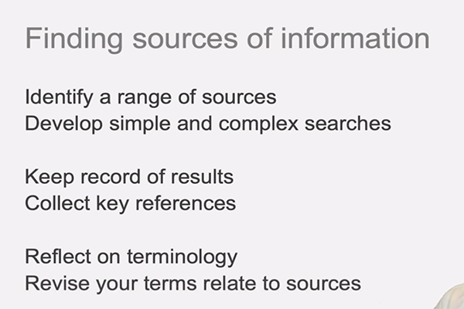

Slide 12
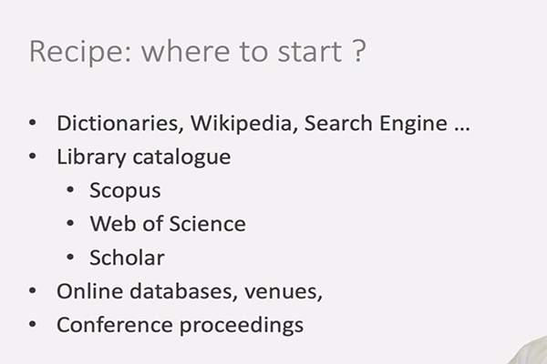

Slide 13
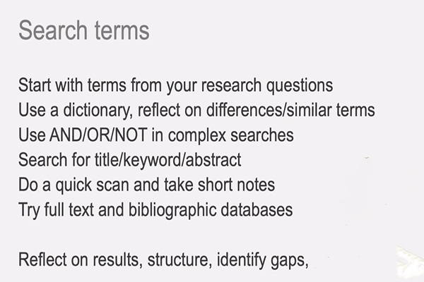

Slide 14
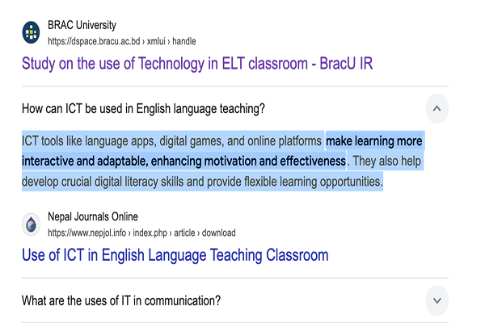
Google search

Slide 15
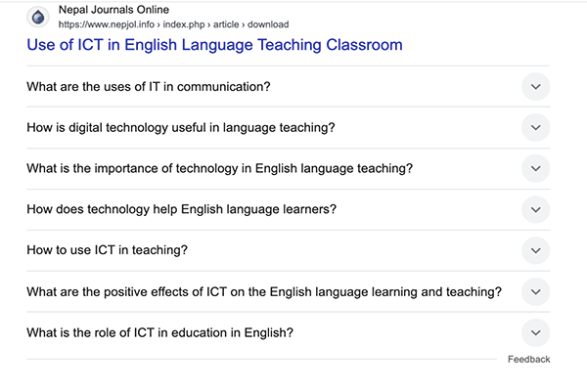

Slide 16
ICT tools
Tools like language apps, digital games, and online platforms make learning more interactive and adaptable, enhancing motivation and effectiveness. They also help develop crucial digital literacy skills and provide flexible learning opportunities.

Slide 17
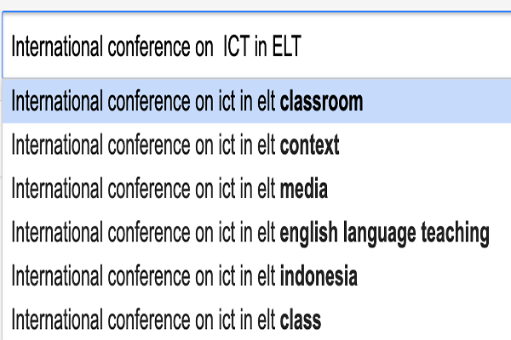
Venues as source…

Slide 18
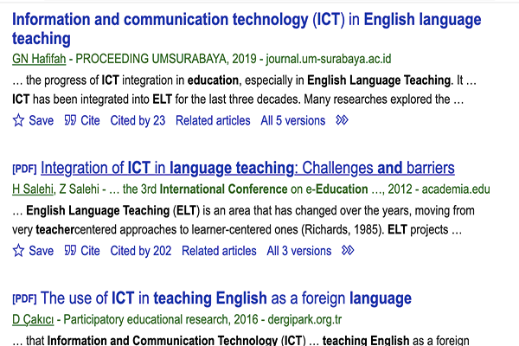

Slide 19
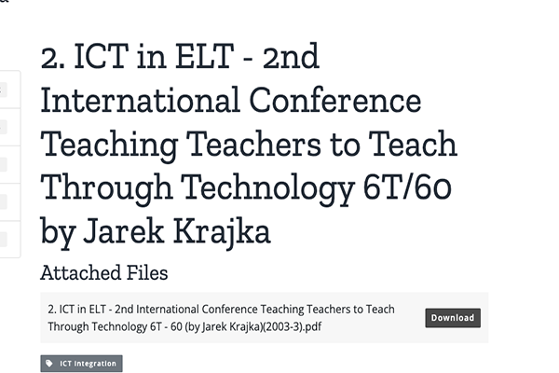

Slide 20
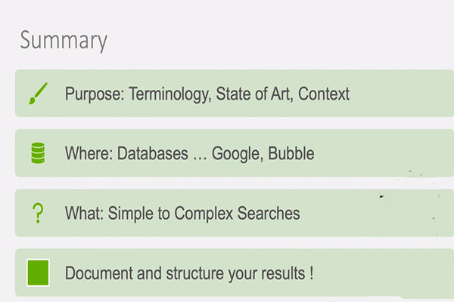

Slide 21
Thank you for watching ..

