Slide 1
Road of Research
Introduction to Research PPT2

Slide 2
Why research
In a world filled with countless questions, we are constantly seeking answers and striving for improvement.

Slide 3
Curiosity/Need
Curiosity and the desire for a better life drive us to explore and understand the challenges that surround us. From the knowledge and insights gained through research, we can address these needs and make meaningful progress.

Slide 4
Research is crucial in satisfying people's needs and addressing their curiosity. It arises from the recognition of problems and the quest for knowledge.

Slide 5
Topics/ Subjects
Whether it's understanding the causes of diseases like malaria, tackling poverty in African communities, improving education in villages, becoming proficient academicians, harnessing the power of technology, or examining the impact of student cell phone usage in schools, research allows us to delve deeper into these subjects and find solutions.

Slide 6
This course
This course serves as an introduction to the meaning, types, assumptions, characteristics, importance, and process of research.

Slide 7
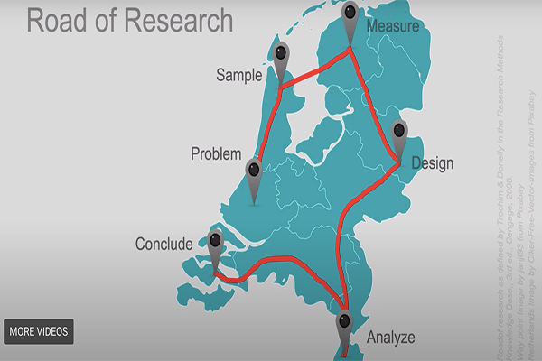
Research Journey

Slide 8
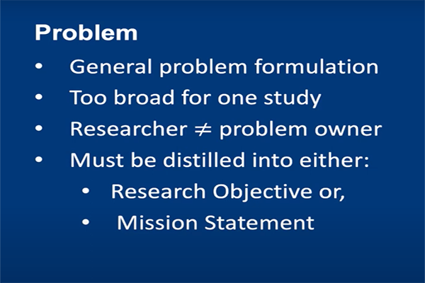
Problem: Delimit topic

Slide 9
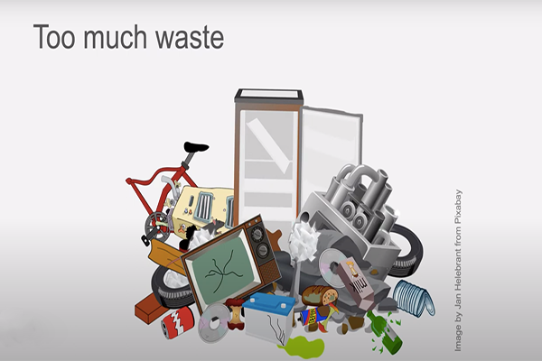
Example problem: Waste

Slide 10
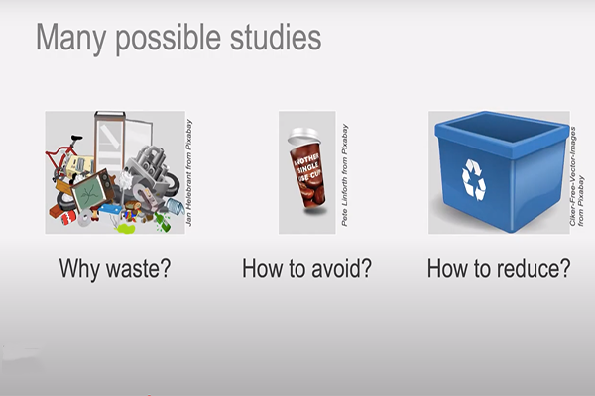
Studies, Angles, Approach

Slide 11
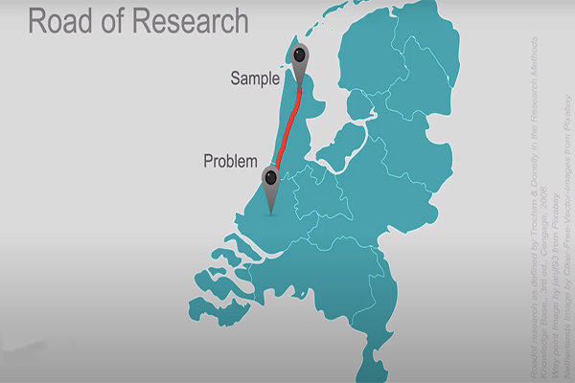
Sample

Slide 12
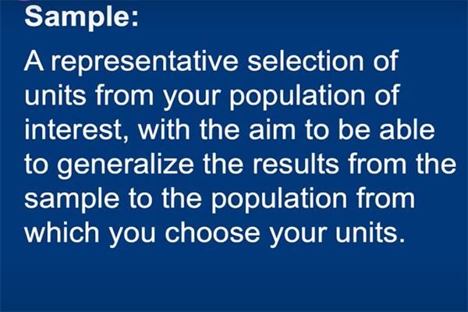
Sampling

Slide 13
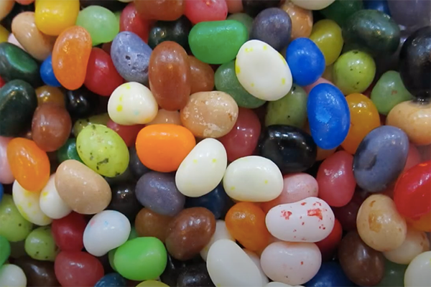
Target population: Jelly beans

Slide 14
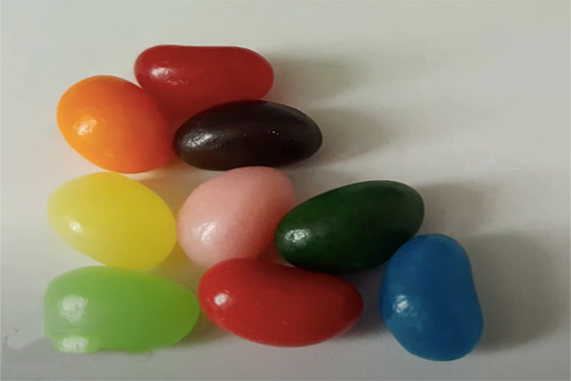
Limited sample: Size

Slide 15

Limited sample: Type

Slide 16
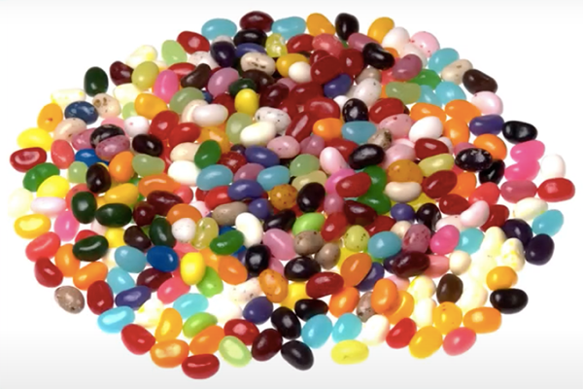
A sizeable sample

Slide 17
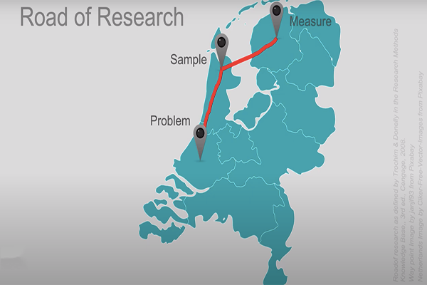
Measure

Slide 18
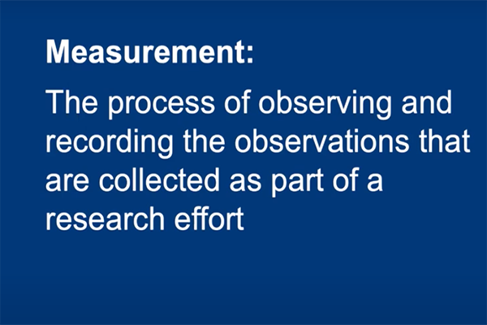
Measure: Observation, Questionnaire, Interview, etc.

Slide 19
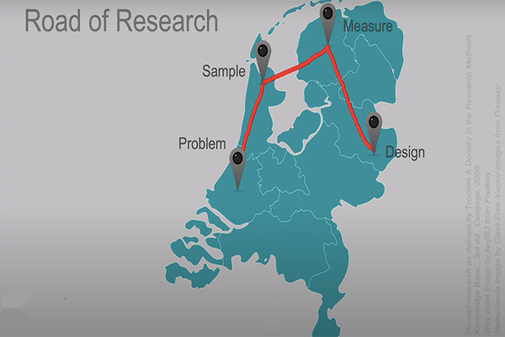
Design

Slide 20
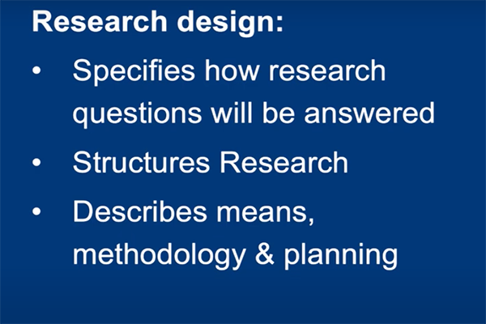
Design: Questions

Slide 21
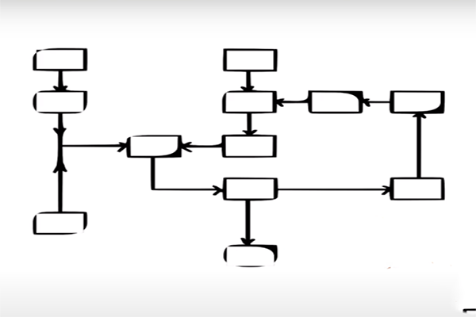
Analyze: Hierarchies, Structure

Slide 22

Analyze: Tables, Graphs, etc.

Slide 23

Analyze

Slide 24
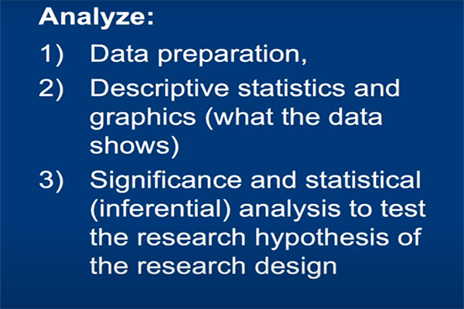
Analyze

Slide 25
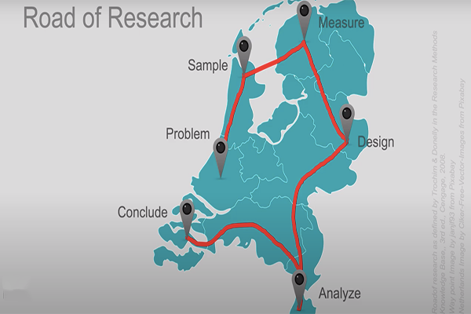
Conclude

Slide 26
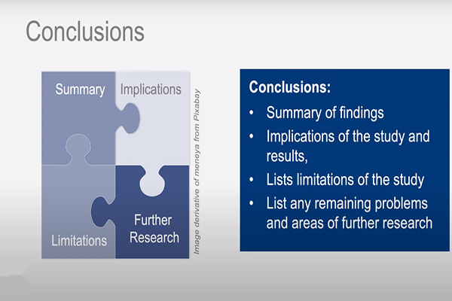
Conclusions

